Slide 1
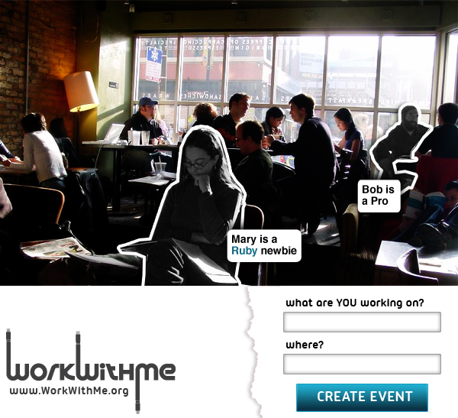
@workwithmeorg
Nikita Bernstein
Ying Dong
Corrie Lee
Andres Alfonso

Slide 2
Coworking?
I am your biggest fan

Slide 3
Next Step
Messaging through the page
Information about Cafes
Trust-based Network
Getting me some developers for JoVE… and JoVE is… the first PubMed indexed video methods journal…

Slide 4
Interesting Insight
Market Research: Spoke to customers
20 people at 5 cafes
Technical/Science Researchers
Students prepping for tests (GRE and such)

Slide 5
Marketing
Word of Mouth
Existing Coworking community
Meetup / Tech groups
Other top-secret strategies

Slide 6
Competition

Slide 7
MONEY MONEY MONEY
Advertising (hockey stick curve)
Talent – HR Departments
Market Analysis – who is using what?

Slide 8
PAIN!

Slide 9
@workwithmeorg
Nikita Bernstein
Ying Dong
Corrie Lee
Andres Alfonso

